Slide 1
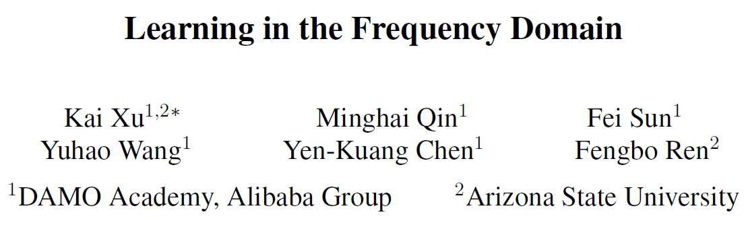

Slide 2
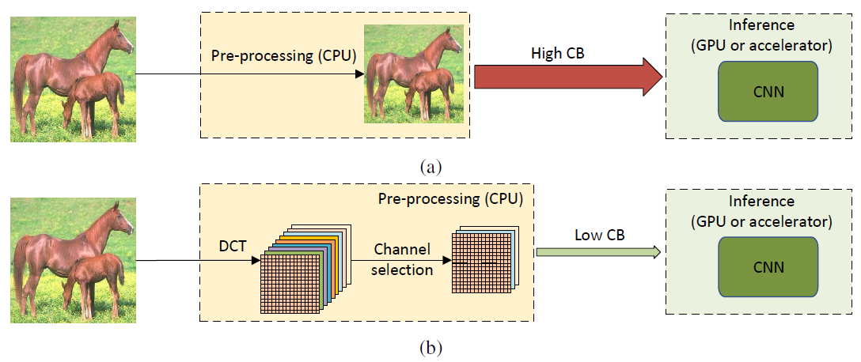
Learning in the Frequency Domain

Slide 3
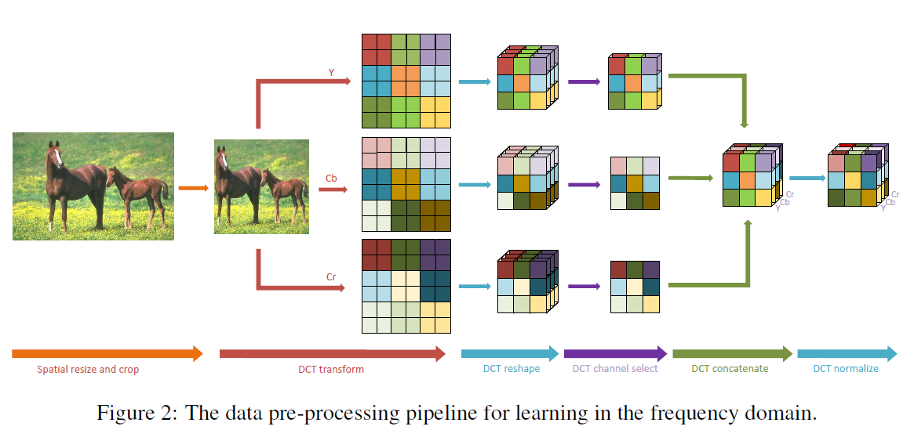
Data Preprocessing in the Frequency Domain
H x W x 1
H/8 x W/8 x 64

Slide 4
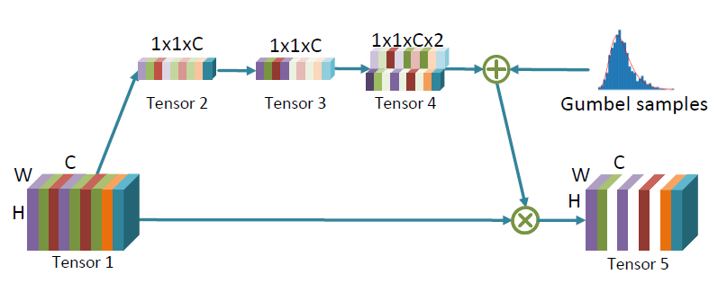
Learning based Frequency Channel Selection

Slide 5
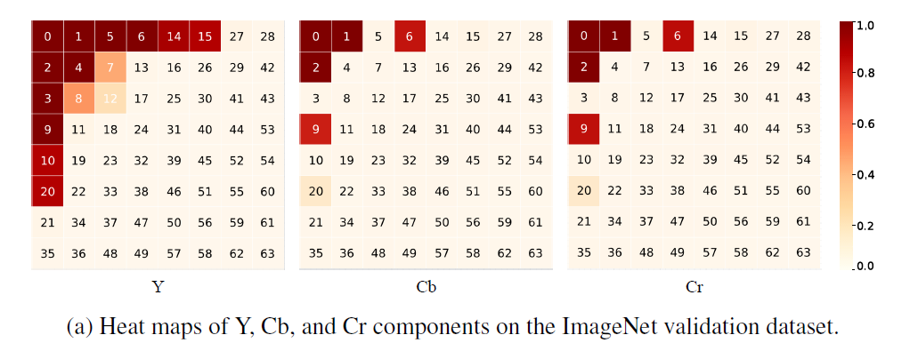
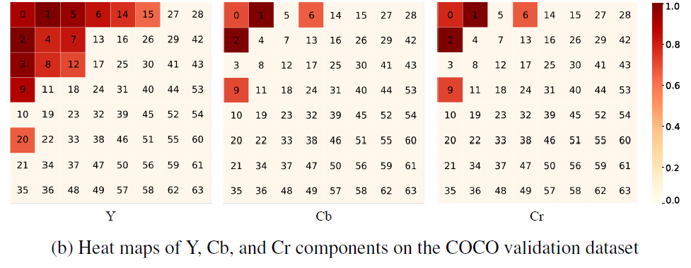
Static Frequency Channel Selection

Slide 6
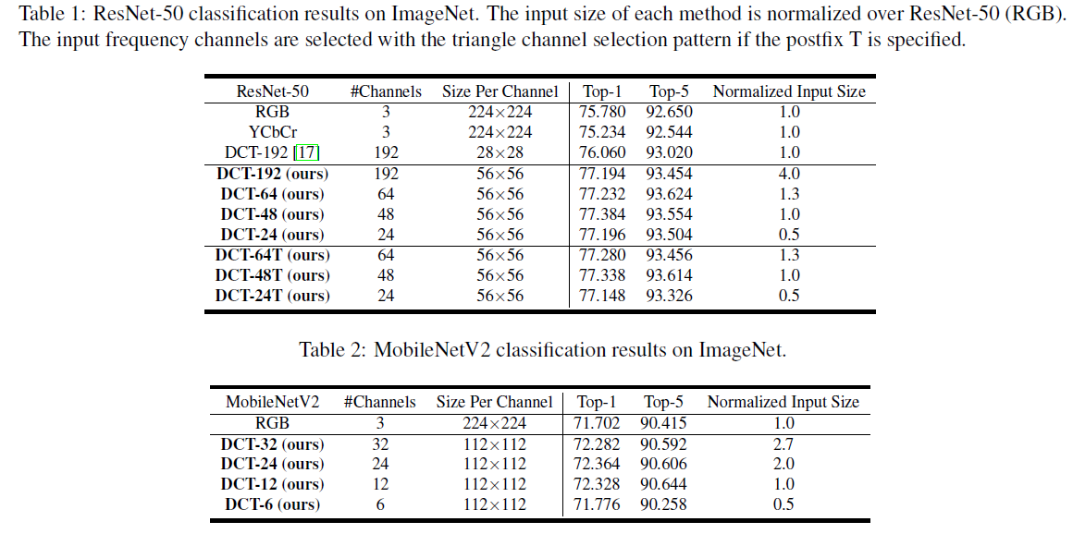



Experiment Results on Image Classification

Slide 7
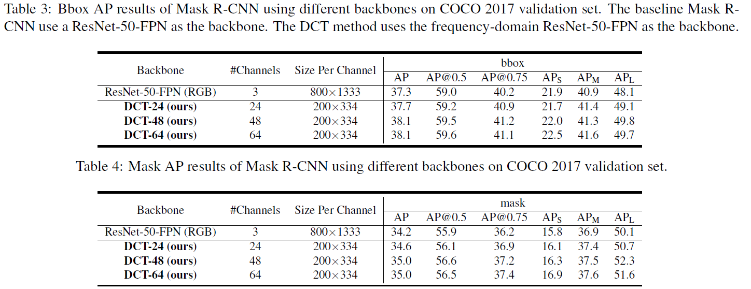
Experiment Settings on Object Detection And Instance Segmentation

